Slide 1
Stack Applications Arithmetic Expression
Three Forms of expression:
a. Infix b. Postfix c. Prefix
Infix to postfix conversion using Stack

Slide 2
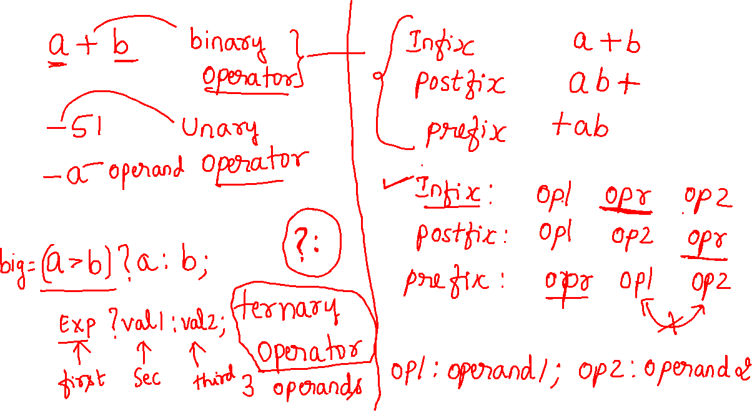

Slide 3
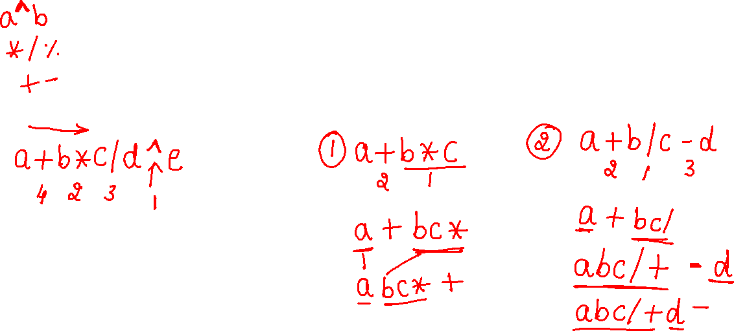
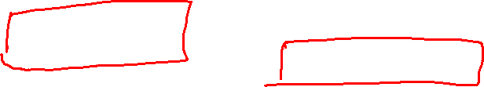

Operator | Associativity | Precedence
^ | Left to Right | 1 (highest)
* / % | Left to Right | 2
+ - | Left to Right | 3 (lowest)
Here only the binary operators ^ * / % + - are considered

Slide 4
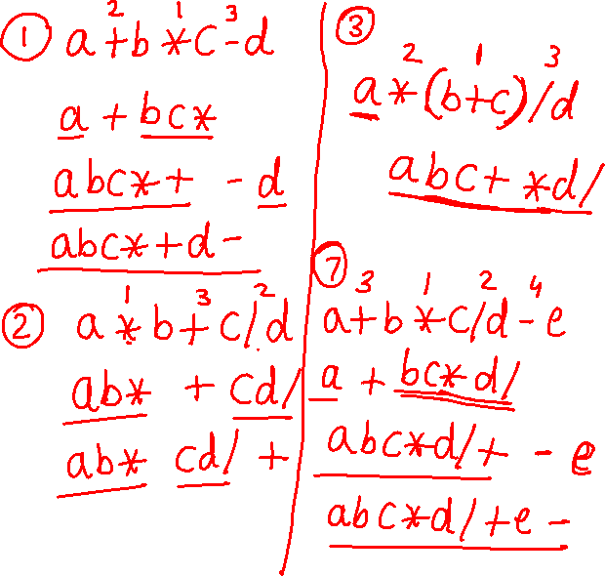
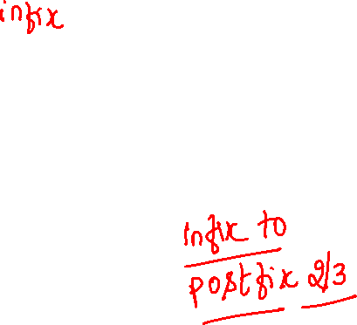


Sl. No. | Infix
1 | a+b*c-d
2 | a*b+c/d
3 | a*(b+c)/d
4 | a*(b+c/d)
5 | (a*b)+(c/d)
6 | (a*(b+c))/d
7 | a+b*c/d-e
8 | (a+b)*c/d-e
9 | (a+b)*(c-d)/(e+f)
10 | (a+b)*(c-d)/((e-f)*(g+h))
11 | a+b*c-d/e*f
12 | a/b^c+d*e-f*g

Slide 5
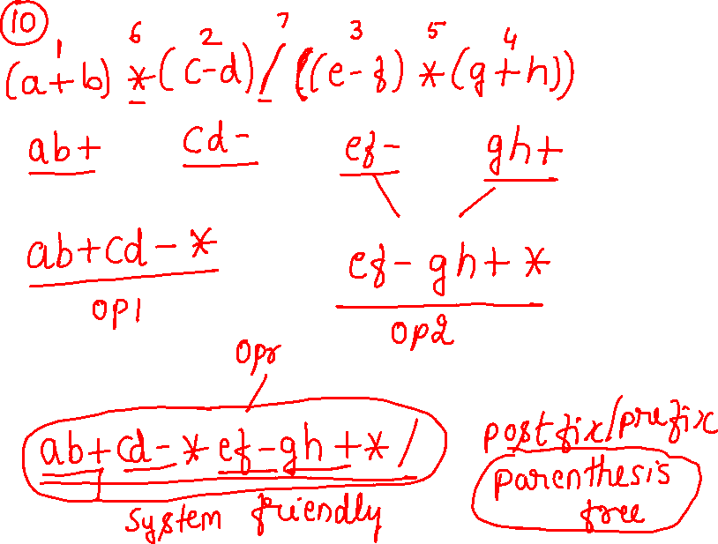
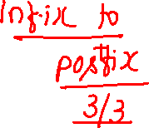
Sl. No. | Infix
1 | a+b*c-d
2 | a*b+c/d
3 | a*(b+c)/d
4 | a*(b+c/d)
5 | (a*b)+(c/d)
6 | (a*(b+c))/d
7 | a+b*c/d-e
8 | (a+b)*c/d-e
9 | (a+b)*(c-d)/(e+f)
10 | (a+b)*(c-d)/((e-f)*(g+h))
11 | a+b*c-d/e*f
12 | a/b^c+d*e-f*g

Slide 6
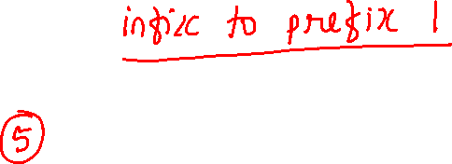
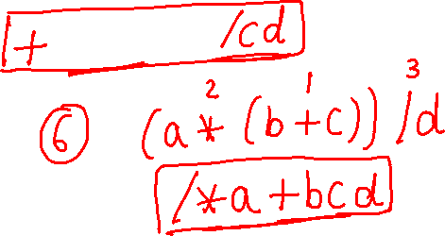
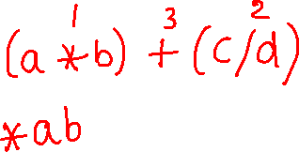

Sl. No. | Infix
1 | a+b*c-d
2 | a*b+c/d
3 | a*(b+c)/d
4 | a*(b+c/d)
5 | (a*b)+(c/d)
6 | (a*(b+c))/d
7 | a+b*c/d-e
8 | (a+b)*c/d-e
9 | (a+b)*(c-d)/(e+f)
10 | (a+b)*(c-d)/((e-f)*(g+h))
11 | a+b*c-d/e*f
12 | a/b^c+d*e-f*g

Slide 7
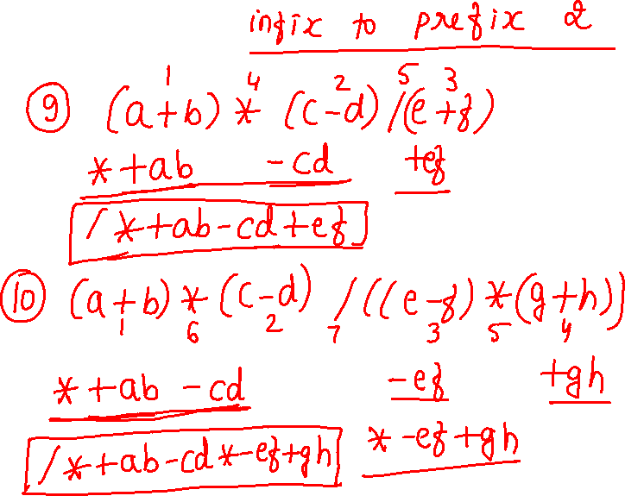

Sl. No. | Infix
1 | a+b*c-d
2 | a*b+c/d
3 | a*(b+c)/d
4 | a*(b+c/d)
5 | (a*b)+(c/d)
6 | (a*(b+c))/d
7 | a+b*c/d-e
8 | (a+b)*c/d-e
9 | (a+b)*(c-d)/(e+f)
10 | (a+b)*(c-d)/((e-f)*(g+h))
11 | a+b*c-d/e*f
12 | a/b^c+d*e-f*g

Slide 8
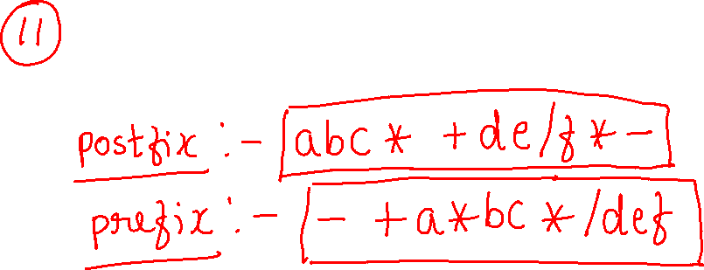
a+b*c-d/e*f

Slide 9
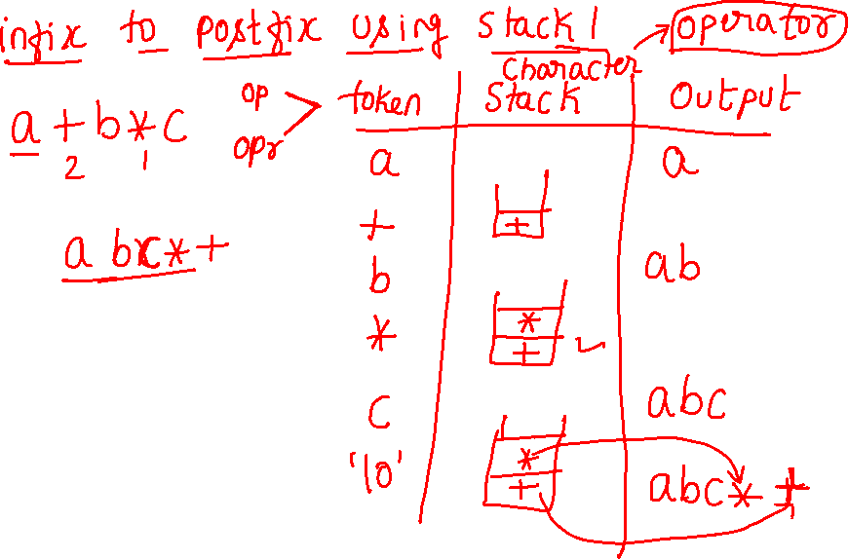

Slide 10
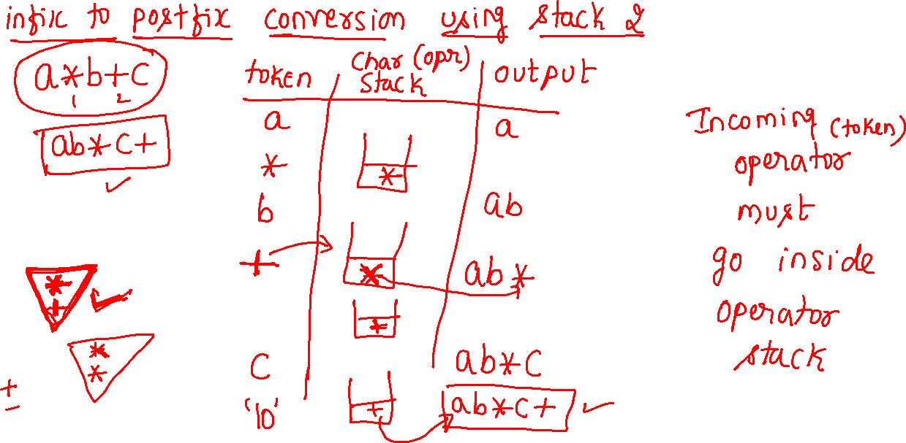

Slide 11
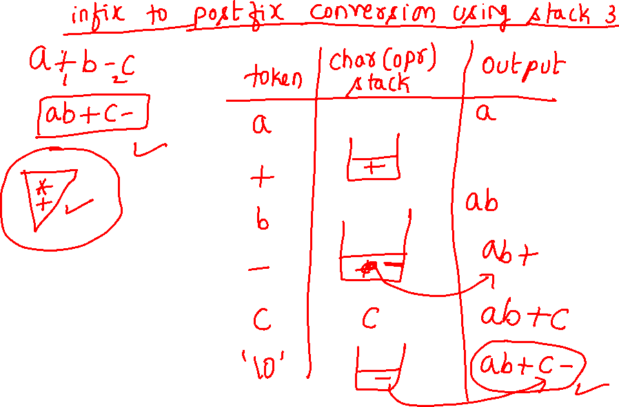

Slide 12
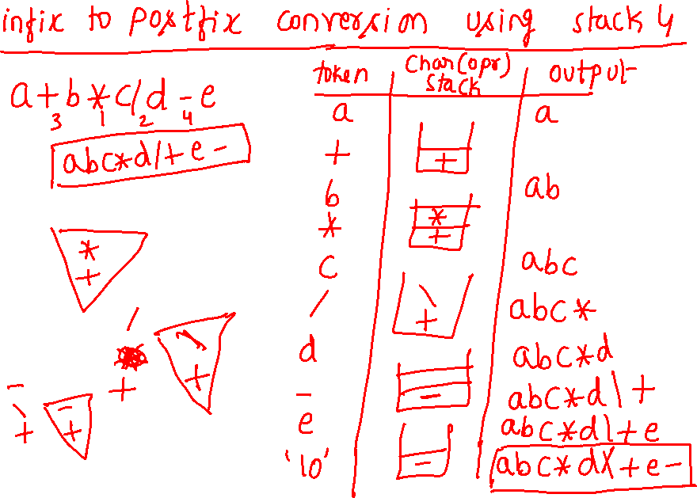

a+b*c/d-e

Slide 13
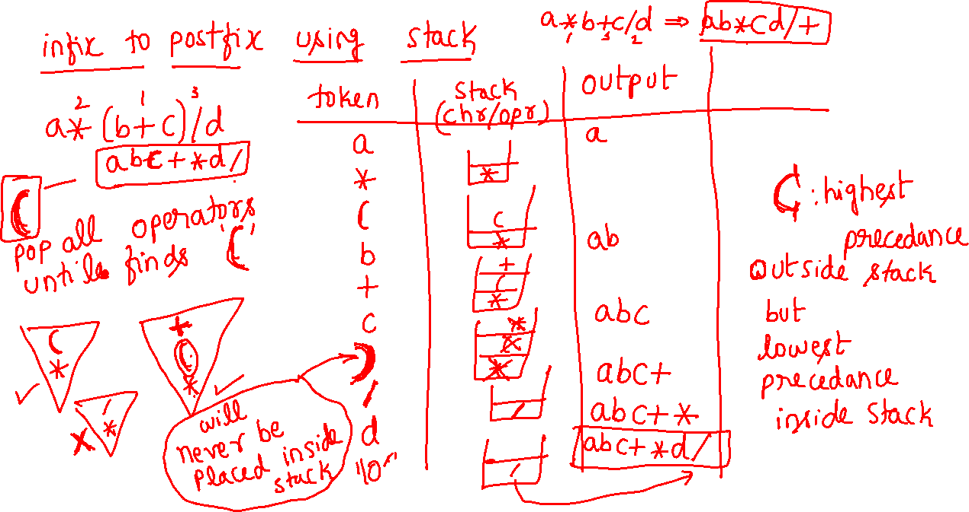
a*(b+c)/d

Slide 14
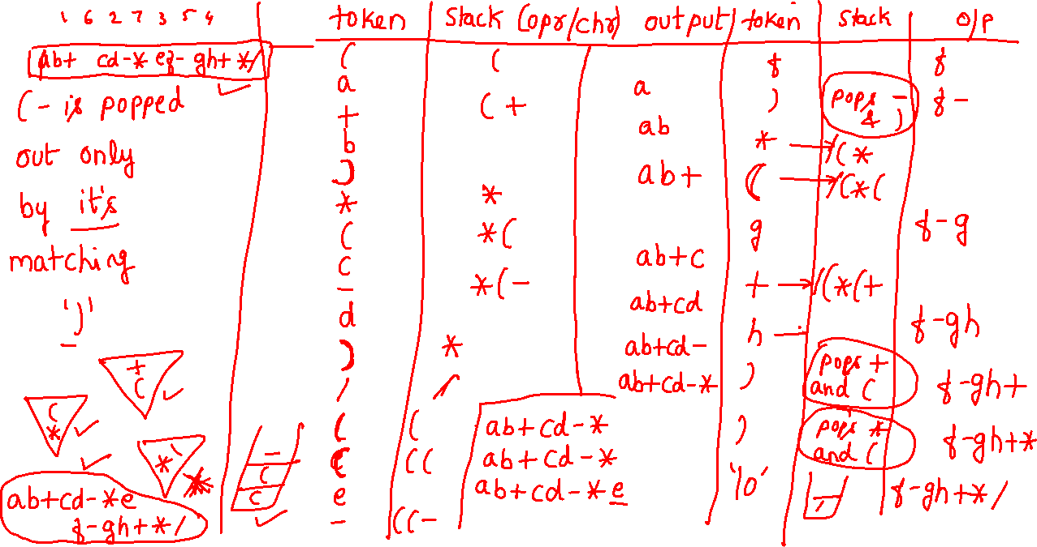
(a+b)*(c-d)/((e-f)*(g+h))

Slide 15
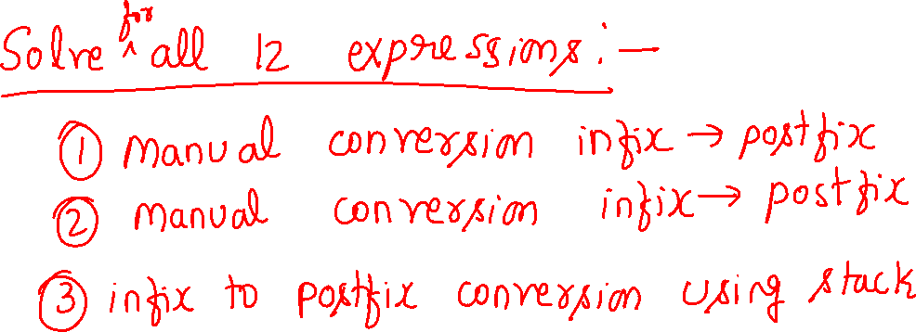

Slide 16
Sl. No. | Infix | Postfix | prefix
1 | a+b*c-d | abc*+d- | -+a*bcd
2 | a*b+c/d | ab*cd/+ | +*ab/cd
3 | a*(b+c)/d | abc+*d/ | /*a+bcd
4 | a*(b+c/d) | abcd/+* | *a+b/cd
5 | (a*b)+(c/d) | ab*cd/+ | +*ab/cd
6 | (a*(b+c))/d | abc+*d/ | /*a+bcd
7 | a+b*c/d-e | abc*d/+e- | -+a/*bcde
8 | (a+b)*c/d-e | ab+c*d/e- | -/*+abcde
9 | (a+b)*(c-d)/(e+f) | ab+cd-*ef+/ | /*+ab-cd+ef
10 | (a+b)*(c-d)/((e-f)*(g+h)) | ab+cd-*ef-gh+*/ | /*+ab-cd*-ef+gh
11 | a+b*c-d/e*f | abc*+de/f*- | -+a*bc*/def
12 | a/b^c+d*e-f*g | abc^/de*+fg*- | -+/a^bc*de*fg
Postfix is not reversal of prefix
Prefix is not reversal of postfix

